Slide 1

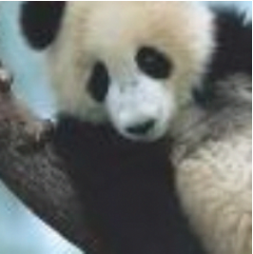
Insight to computer vision

Slide 2
Contents
01
02
03
Overview
Metrics
Non-Max Suppression
Introduction to CV
Object detection
Intersection over Union (IoU)
Mean average precision (mAP)
Common algorithm to tackle multiple bounding boxes

Slide 3
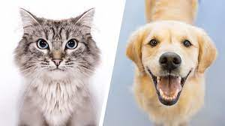
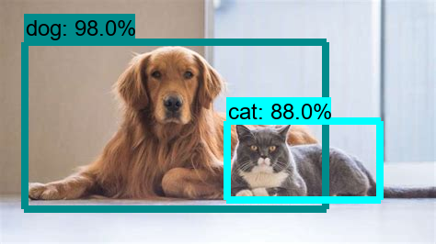
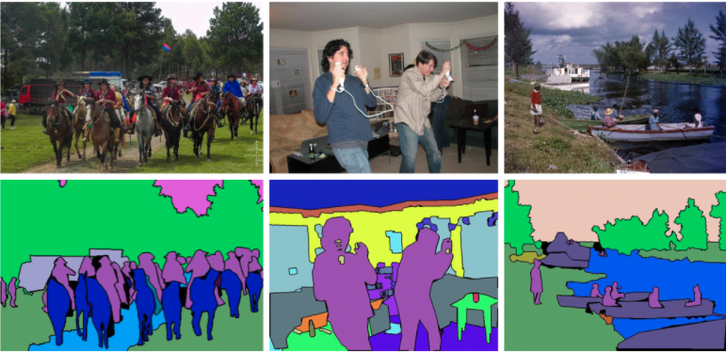
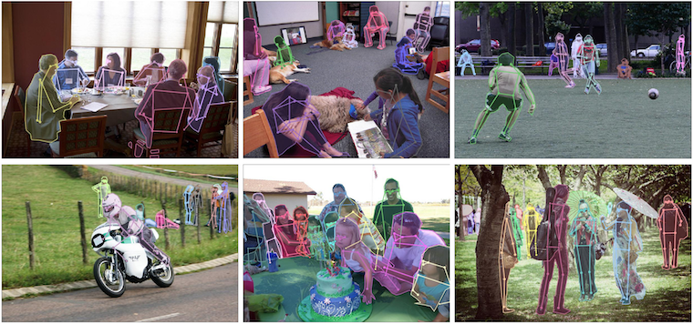
Overview – What is CV?
Classification
Object detection
Image Segmentation (panoptic)
Keypoint detection
and many more…

Slide 4
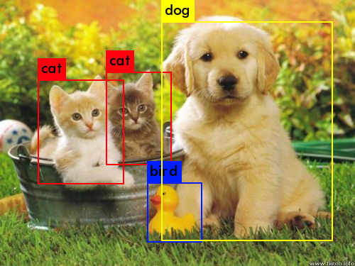
Object Detection Task
Localization (regression)
Localized the subject in the image
Done by drawing bounding boxes (bbox) around the subject
Bbox described as (x1, y1, x2, y2) or (x, y, w, h)
Classification
Classify subject correctly (e.g. cat or dog)

Slide 5
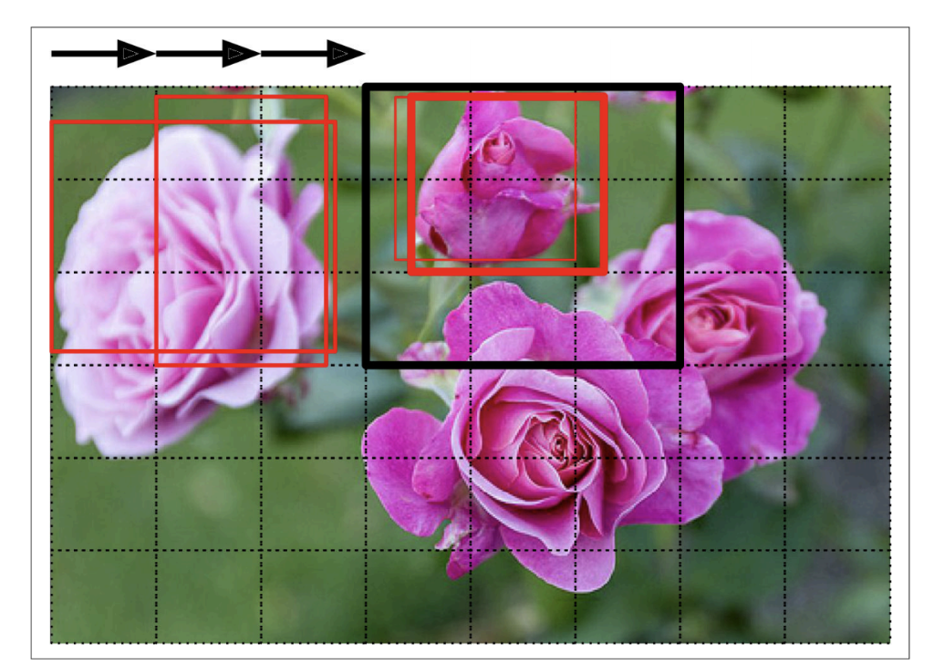
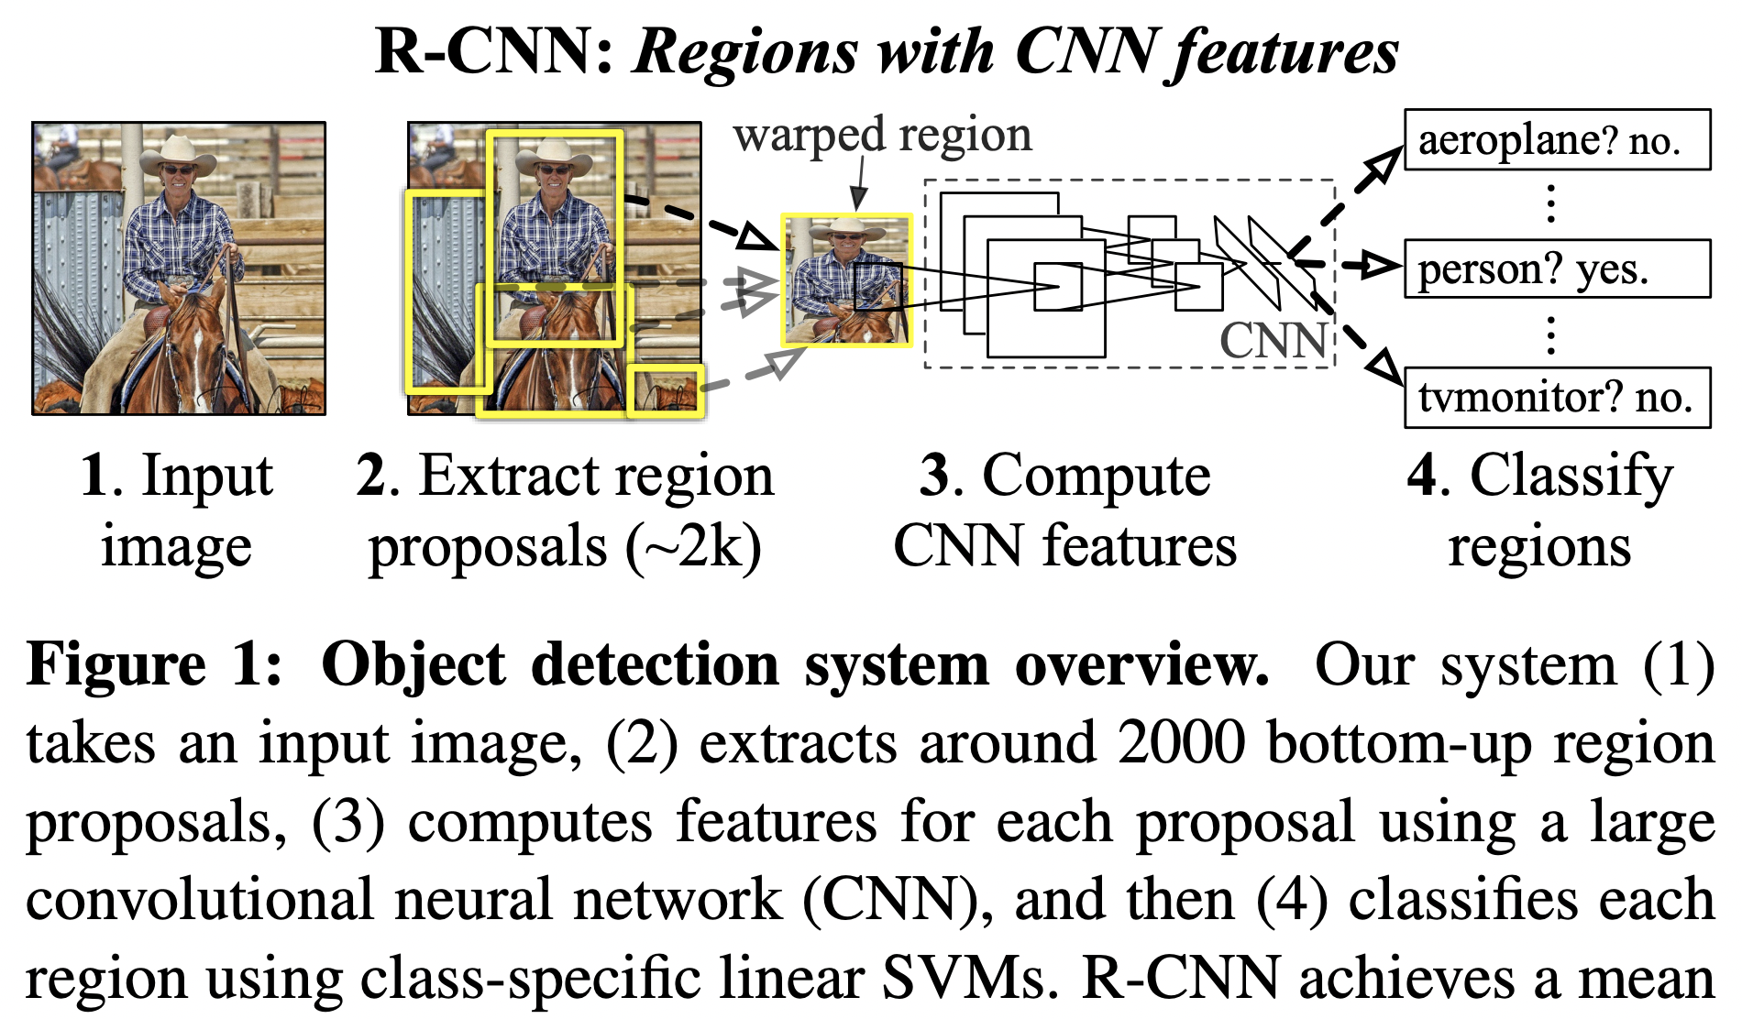
Object detection models
Two-stage models
Region-based CNN Family Models
R-CNN (2014), Fast R-CNN (2015), Faster R-CNN (2016), Mask R-CNN (2017)
More accurate but are typically slower.
Sliding window technique
Region proposal technique

Slide 6
object detection models
One-stage models
YOLO Family Models
YOLO (2015), YOLOv2 (2016), YOLOv3 (2018), YOLOv4 (2020), YOLOv5 (2021)
SSD (2016)
Fast inference speed, but not as good at recognizing a group of small objects

Slide 7
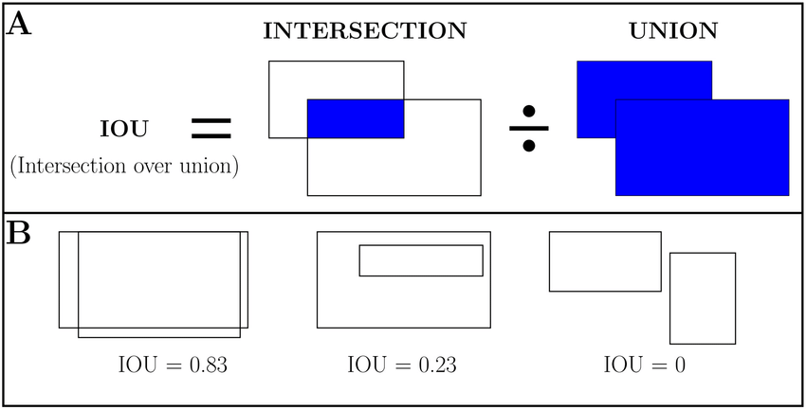
Evaluation metric:
Intersection over Union (IoU)
IoU quantify the amount of overlap area between predicted bbox overlapped with ground-truth bbox
Range from 0 (prediction totally off) to 1 (prefect prediction)
If prediction has IoU > 0.5, correct classification -> TP
If prediction has IoU < 0.5, correct classification -> FP
If no prediction when there is a target -> FN
(0.5 is an arbitrary threshold)

Slide 8
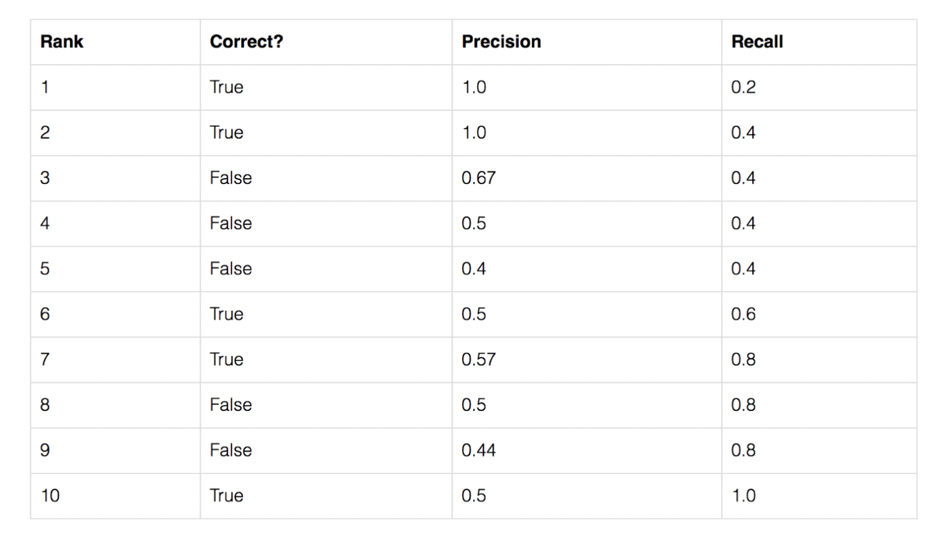
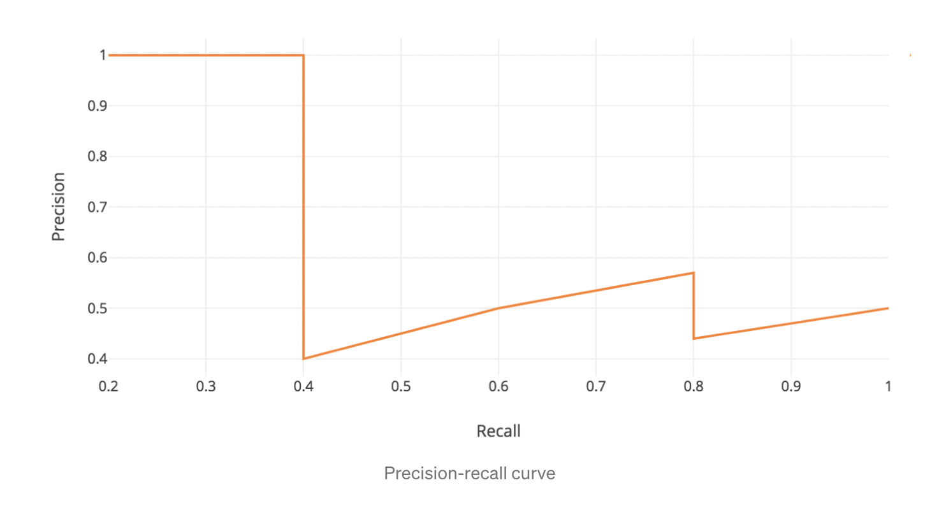
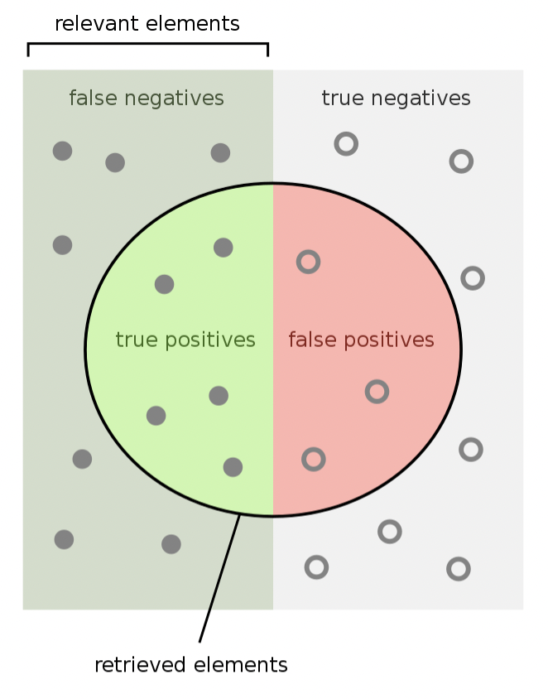
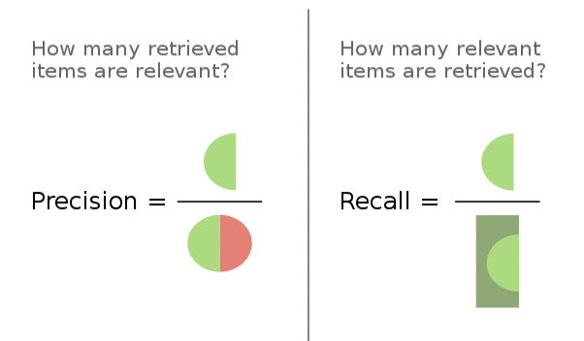
Evaluation metric: Mean Average Precision (mAP)
5 total cases in this e.g.
Based on the concept of IoU, calculate TP, FP, FN to built a precision –recall curve
STEPS :
Sort the predictions by confidence level
Compute the precision and recall for each row sequentially
Plot graph
Calculate area under graph and you get AP!
Repeat this for diff classes and average them e.g. AP_{CAT} , AP_{DOG}
Hence mean AP
1 / 1
1 / 5
2 / 2
2 / 5
2 / 3
2 / 5
2 / 4
2 / 5

Slide 9
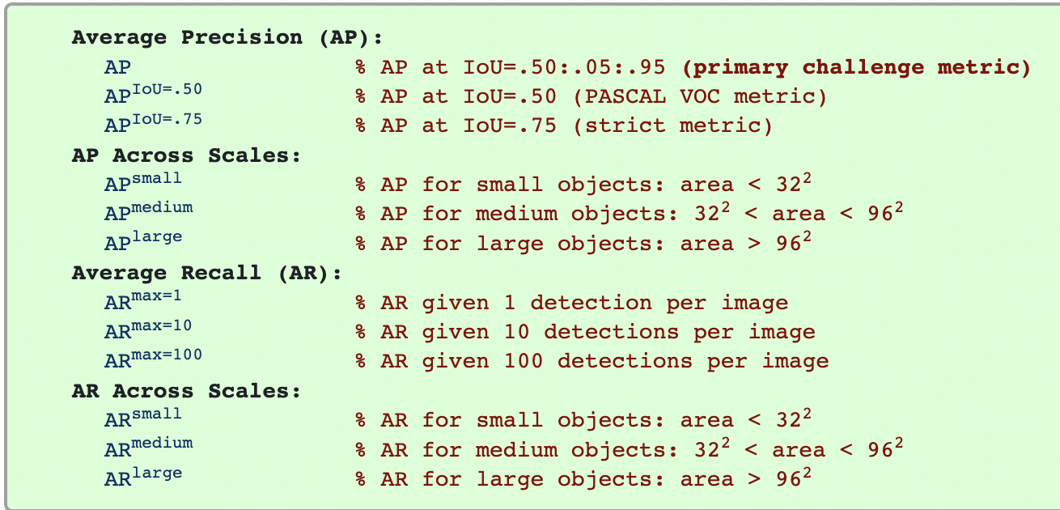
Evaluation metric: Mean Average Precision (mAP)
COCO Object
Detection
Challenge

Slide 10
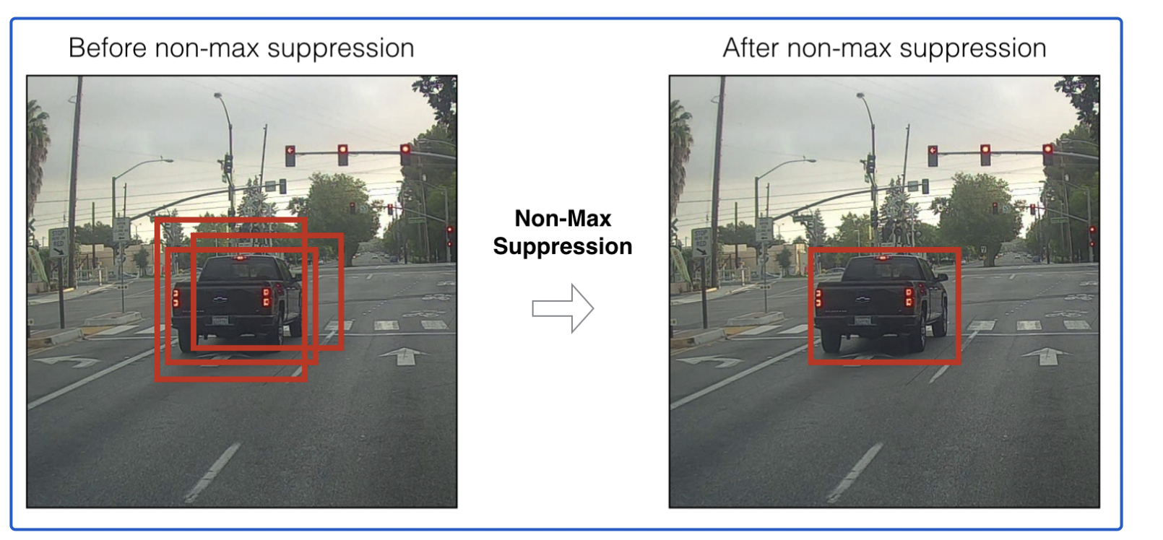
Non-max suppression (NMS)
Most obj detection models proposed multiple bbox around the target.
NMS is a technique to remove all except one bbox proposal

Slide 11



Steps:
Start from one class
Select the bbox with the highest confidence score.
Check the IOU score of other bboxes.
Discard the bbox if IOU > 0.7 (arbitrary threshold
Select the second highest confidence score and repeat step 3 and 4.
Repeat step 1 to 5 for other classes.
0.75
0.5
0.7
0.8
0.66
0.71
0.95
0.9

Slide 12
Steps:
Start from one class
Select the bbox with the highest confidence score.
Check the IOU score of other bboxes.
Discard the bbox if IOU > 0.7 (arbitrary threshold
Select the second highest confidence score and repeat step 3 and 4.
Repeat step 1 to 5 for other classes.
0.75
0.5
0.8
0.66
0.95
0.9

Slide 13
Steps:
Start from one class
Select the bbox with the highest confidence score.
Check the IOU score of other bboxes.
Discard the bbox if IOU > 0.7 (arbitrary threshold
Select the second highest confidence score and repeat step 3 and 4.
Repeat step 1 to 5 for other classes.
0.75
0.8
0.95
0.9

Slide 14
Steps:
Start from one class
Select the bbox with the highest confidence score.
Check the IOU score of other bboxes.
Discard the bbox if IOU > 0.7 (arbitrary threshold
Select the second highest confidence score and repeat step 3 and 4.
Repeat step 1 to 5 for other classes.
0.75
0.8
0.95

Slide 15
Bbox proposal
0.75
Steps:
Start from one class
Select the bbox with the highest confidence score.
Check the IOU score of other bboxes.
Discard the bbox if IOU > 0.7 (arbitrary threshold
Select the second highest confidence score and repeat step 3 and 4.
Repeat step 1 to 5 for other classes.
0.8
0.75
Problem?
NMS performed poorly if targets are close
0.8
0.8
Expectation
After NMS

Slide 16
Thanks !

